Slide 1

International Software projects The Mantid Model
Nick Draper
Tessella
www.mantidproject.org

Slide 2
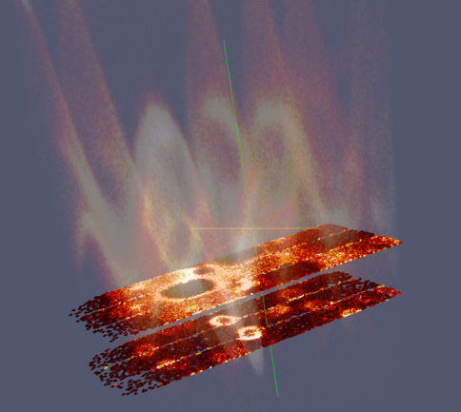
Overview
Mantid Introduction
A Selection of Risks
Management strategies
Conclusion

Slide 3

Project Goals
Goals
Consolidate the data reduction/analysis software for neutron scattering without restricting the needs of the instrument scientists
Key requirement
Create a Data Analysis framework
not instrument or technique/dependent
Cross-platform
Windows, Linux, Mac
Easily extensible
Open source

Slide 4

A Selection of Risks
Lasting engagement with a large number of stakeholders
Design needs to support flexibility for future needs
Technical single point of failure
Development continuity across the team
Larger development teams are less efficient
Testing and deployment takes time & Active development can affect robustness

Slide 5
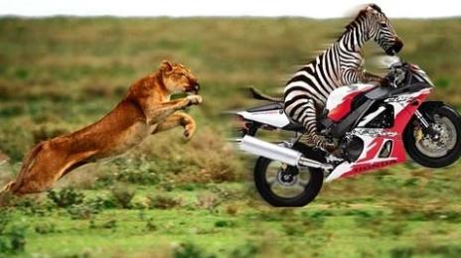
Lasting engagement with a large number of stakeholders
ISIS
SNS/HIFR
Project Organisation
Active project sponsors
Frequent releases
Responsive to change
Users
Scientific Steering Committee
Development Team
Users
Scientific Steering Committee
Development Team
Project Management Board

Slide 6
Design needs to support flexibility for future needs
Separation of Data and Algorithms
Encapsulated “User Code” in specific places
Algorithms
Workspaces
Use of well designed interfaces to allow generic use of components
Reuse of existing components
Careful memory management when handling large datasets

Slide 7

Architectural Design - Overview
Instrument log files
Python
Command line & Scripting interface
Mantid Framework
RAW data files
API
Algorithms
Workspaces
MantidPlot Graphing and analysis
NEXUS data files
User Defined
User Defined
DAE direct access
Future Instrument specific UI
Future Instrument specific UI

Slide 8
Plug in extensions
Algorithm Dialogs Custom Interfaces Custom Menus
Python scripts & libraries
Workflow Algorithms
Algorithms
Unit Conversions
Fit Functions Cost Models Constraints Minimizer
Workspaces
Archive Searching LiveData Listeners Data Catalogs
GUI
Framework
Utility

Slide 9
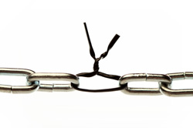
Preventing single points of failure
No “Code Ownership”
Functionality protected via unit tests
Mobile development talent
Sub project teams to focus on significant developments
Knowledge transfer
Daily & focused skype meetings
Code reviews
Architectural and detailed design documentation
Developer documentation
Annual developer meetings

Slide 10
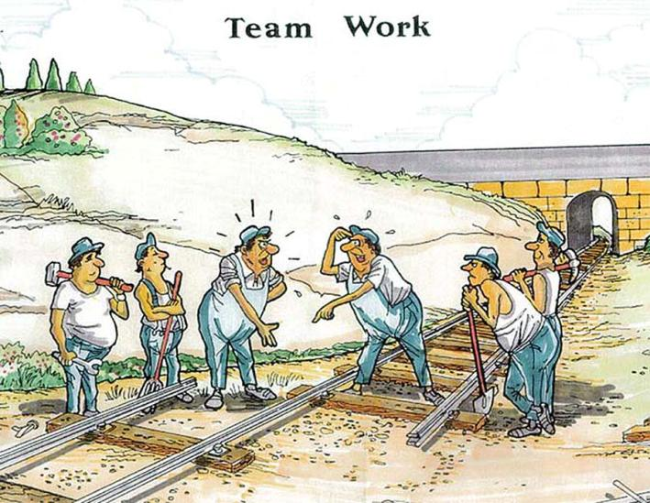
Development continuity across the team
Coding standards
Sensible
Agreed
Shared code ownership
Support within the team
Mentoring
Training
Design and code reviews
Developer meetings

Slide 11
Larger development teams are less efficient
Automate repetitive tasks
Saves time
Ensures they happen
Optimize meeting time
Control attendees at meetings
Use the right technology
Daily skype chat meetings
Ensure the right people talk together
Use tools to prevent duplicated work and missed tasks
Development
Testing

Slide 12

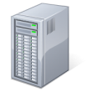
Continuous Integration Environment
Deploy to
Download site
Mantid Project Wiki
GitHub Repository
Automated System test
Build + unit test
-Linux (RHE & Ubuntu)
-Mac OSX
-Windows 32
-Windows 64
trac Issue
tracking
system
Developers

Slide 13

Testing and deployment takes time & Active development can affect robustness
Automated Unit Testing
Test individual components
5,222 tests
Fast – just a few minutes
Run on all platforms on commit
Rapid feedback to developers
Automated System Tests
Test complete workflows
Compare numerical results with stored examples
59 tests
Slow – minutes to hours
Run on all platforms daily
Feedback to all developers

Slide 14
Manual Testing
Developer Testing
Each change tested
Unscripted testing
Whole development team
3-6 days effort
Tests on one of a few environments
Communication and knowledge sharing
Each developer tests other peoples work
Usability and general usage tests
Each environment tested
Low coverage
User Testing
Very high quality feedback & future requirements
Instrument scientists
Only once well tested & interactive development
Generate confidence
Must be well managed

Slide 15

Releases
Development
Automated release
Daily
Full Release
Quarterly
Patch
2-4 weeks after a full release
Full release notes
Wide announcement
If system tests pass
Useful
Not stable
Full manual testing
Targeted testing
Low risk
Targeted improvements & fixes
Code review
Stable
Stable

Slide 16
Conclusion
Software is mission critical to modern neutron facilities
High performance
Reliable
Leading edge
Responsive to change
Maintainable
Well documented
To get these a project needs
Vision
Resource
Stability
Scientific and Technical Leadership
Talented developers

Slide 17
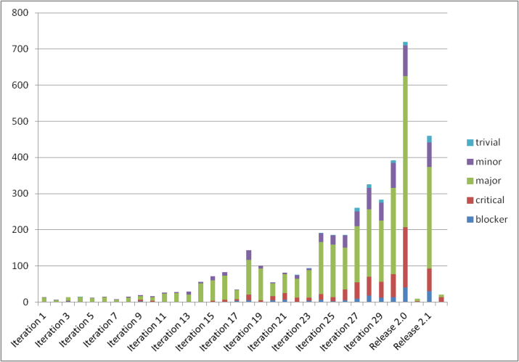

Conclusion
A facility alone can provide these needs
Although many are not used to devoting their resources toward software developments.
Working together between facilities multiplies the benefits over working alone.

Slide 18

Project History
July 2007 Requirements & Design
April 2008 V 1.0 First instrument support
Feb 2010 V1.1 Support multiple techniques
April 2010 Collaboration with SNS & HFIR
Jan 2012 V2.0
Scientist validated results. VATES integration

